Slide 1
Lending Club Case Study
By Elayaraja Muthuraj
EPGP ML and AI, UpGrad

Slide 2
Lending Club is the largest online loan marketplace, facilitating personal loans, business loans, and financing of medical procedures. Borrowers can easily access lower interest rate loans through a fast online interface.
Lending loans to ‘risky’ applicants is the largest source of financial loss (called credit loss).
Credit loss is the amount of money lost by the lender when the borrower refuses to pay or runs away with the money owed.
In other words, borrowers who default cause the largest amount of loss to the lenders. In this case, the customers labelled as 'charged-off' are the 'defaulters’.
Aim of this case study is Identify the risky loan applicants using Exploratory Data Analysis, then such loans can be reduced thereby cutting down the amount of credit loss.
Lending Club wants to understand the driving factors behind loan default and identify the variables which are strong indicators of default.
Problem statement

Slide 3
Case Study Approach
Data Cleansing
Find Columns to apply to Exploratory data analysis methods
Data Analysis
Univariate Analysis
ByVariate Analysis
Plot and charts
Observations

Slide 4
Data Cleansing
Pandas, numpy, seaborn and matplotlib.pyplot libraries used for the analysis
Almost 50+ columns identified with null values are dropped from the data
Derived variables created from Date and year columns of loan issued year
# % to be stripped from intrest rate column and convert emp_length column to have only digit values
converted 'loan_amnt’, 'funded_amnt','int_rate’, 'funded_amnt_inv’, 'installment’, 'annual_inc','dti’, 'emp_length’, 'total_pymnt' columns into numeric data for considering to calculations

Slide 5
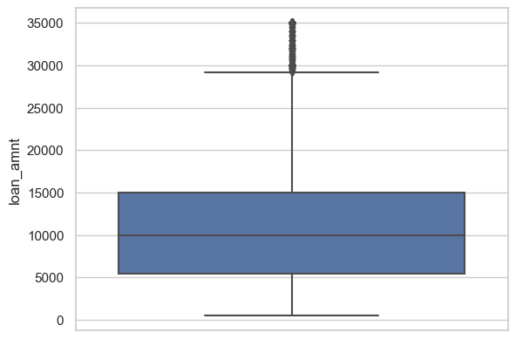
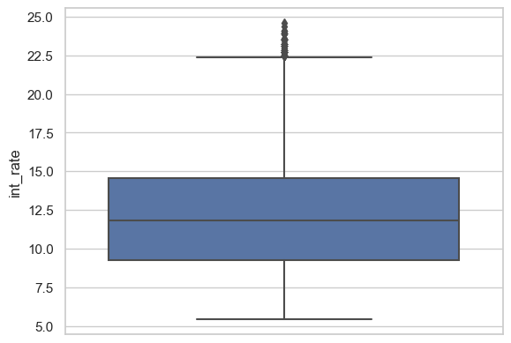
Univaraite Analysis
Most loan amounts within the range of 5000 to 15000
Most loan interest are within the range of 8% to 15%

Slide 6
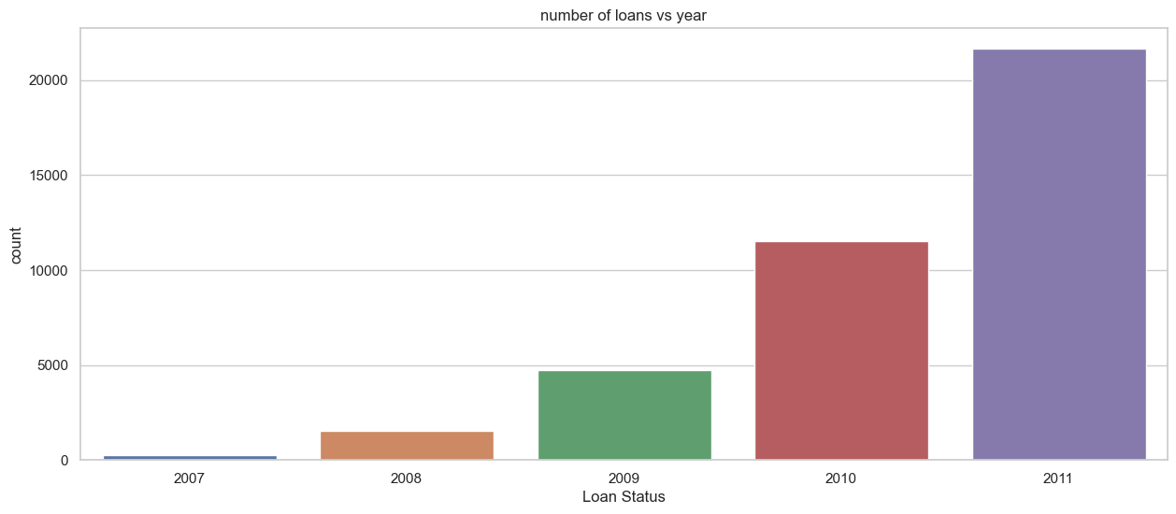
# Looking at loan_status vs int_rate vs issued year by plotting

Slide 7
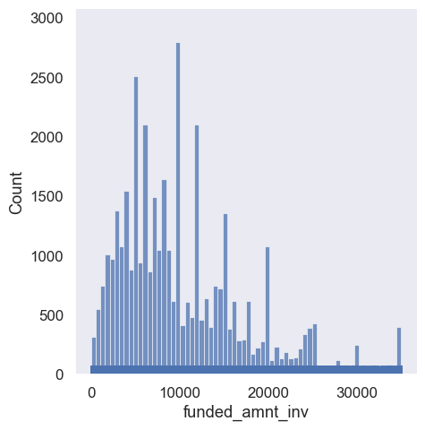
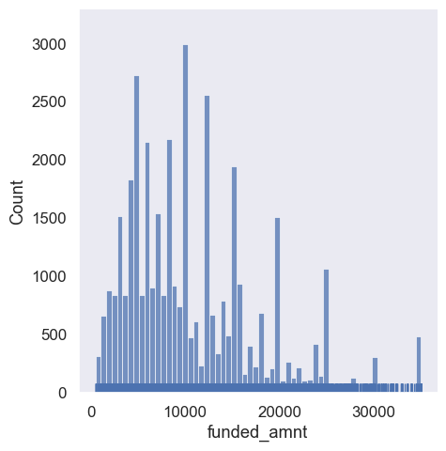
Most loan amounts within the range of 5000 to 15000

Slide 8
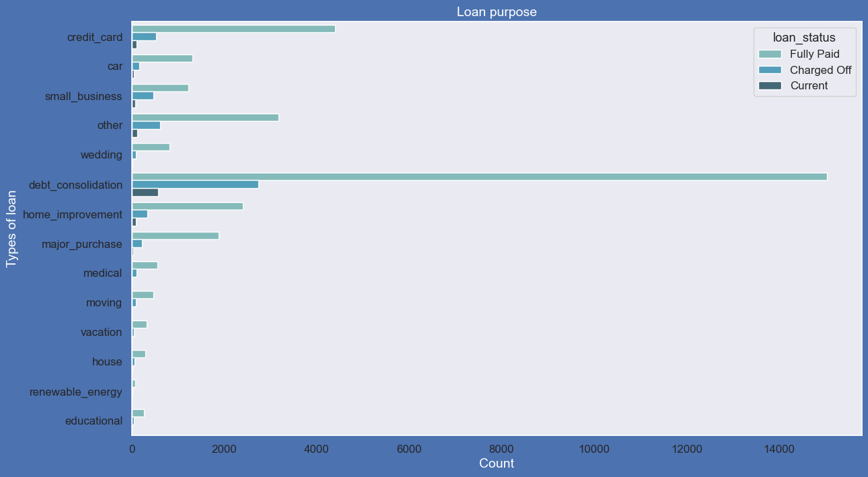
Loan purpose with status

Slide 9
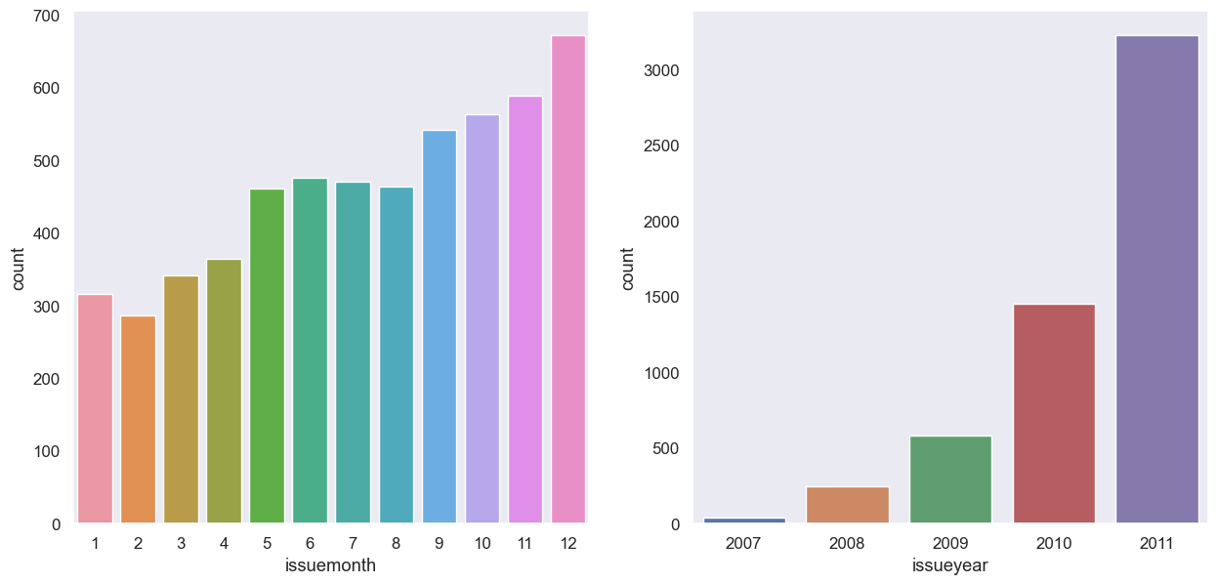
Charged off Loans vs Issued Month and Year

Slide 10
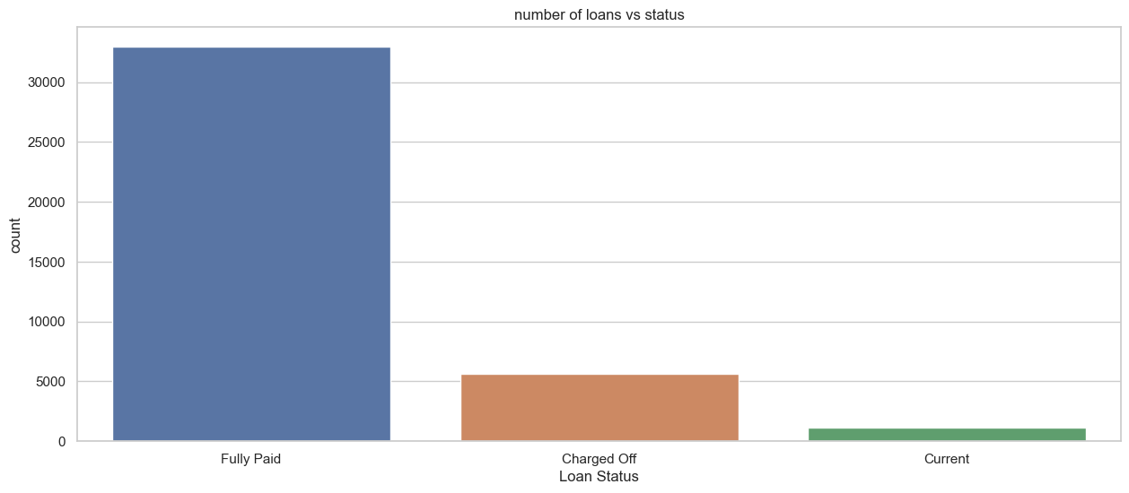
Bivaraite Analysis
# Looking at loan_status vs int_rate vs issued year by plotting

Slide 11
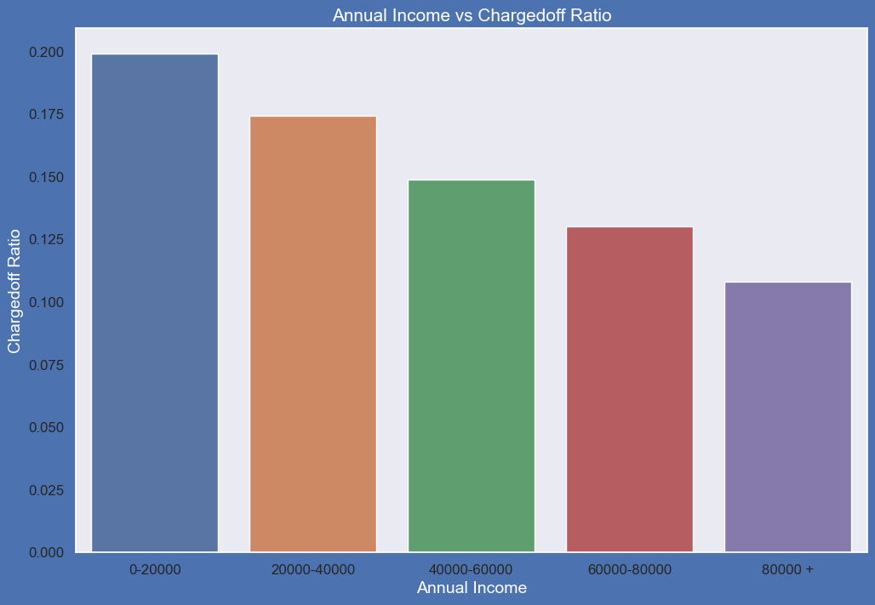
# Bivariate Analysis of annual income versus default rate -
loan_status | annual_inc_grp | Charged Off | Current | Fully Paid | Total | Charged_off_ratio
0 | 0-20000 | 237 | 9 | 943 | 1189 | 0.199327
1 | 20000-40000 | 1514 | 170 | 7004 | 8688 | 0.174263
2 | 40000-60000 | 1729 | 345 | 9534 | 11608 | 0.148949
3 | 60000-80000 | 1024 | 240 | 6597 | 7861 | 0.130263
4 | 80000 + | 1045 | 352 | 8181 | 9578 | 0.108292
# Observations:
# small Business applicants have high chances of getting charged off.
# renewable_energy where chanrged off proportion is better as compare to other categories.

Slide 12
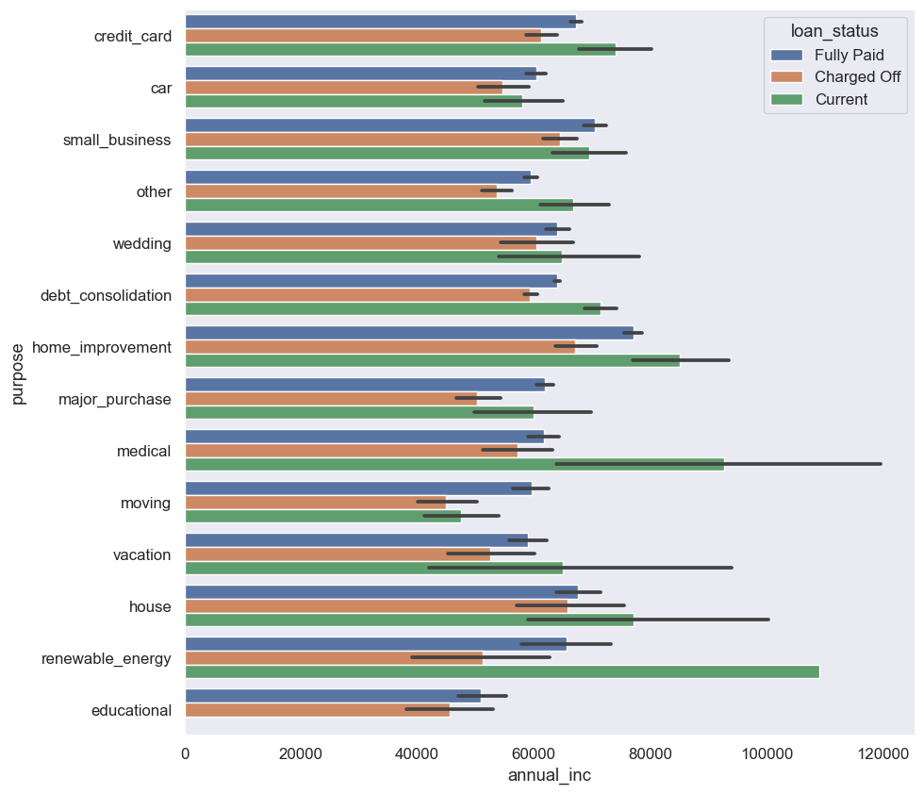
Annual income vs Loan Purpose

Slide 13
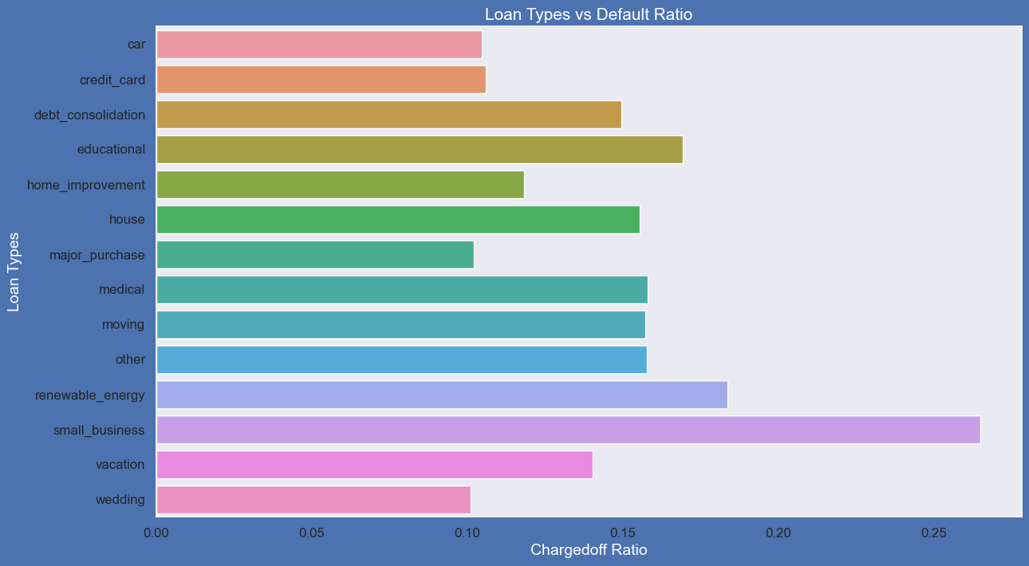
Loan purpose vs Default proportion

Slide 14
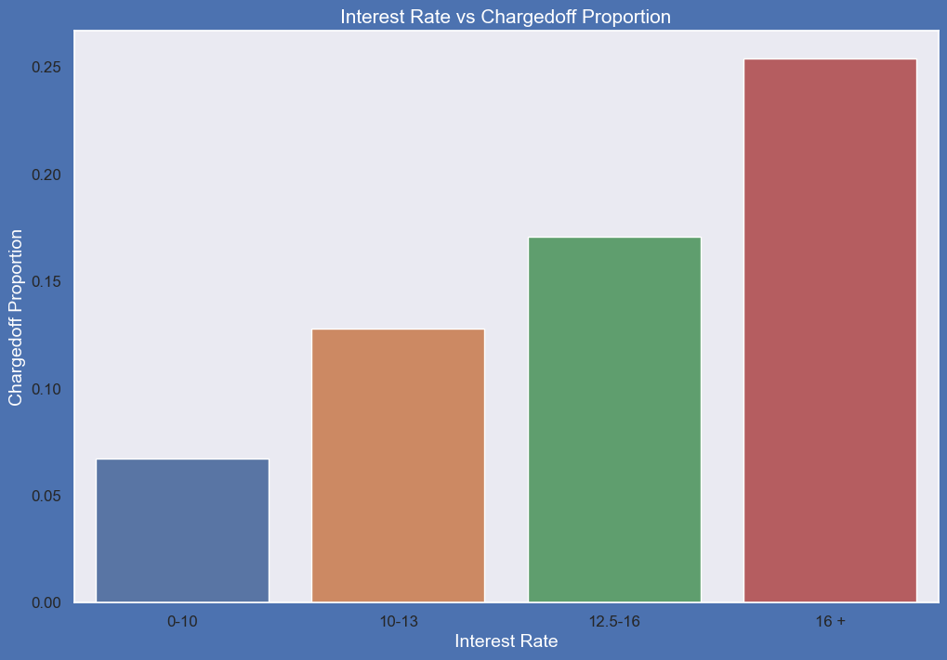
Annual Income vs charged off Proportion

Slide 15
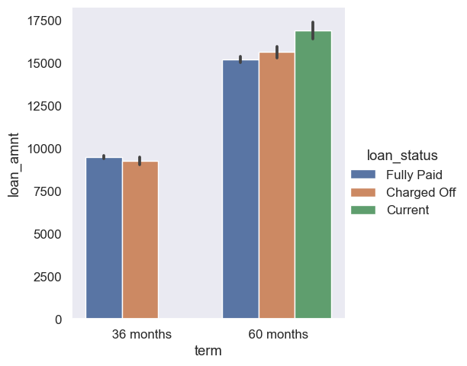
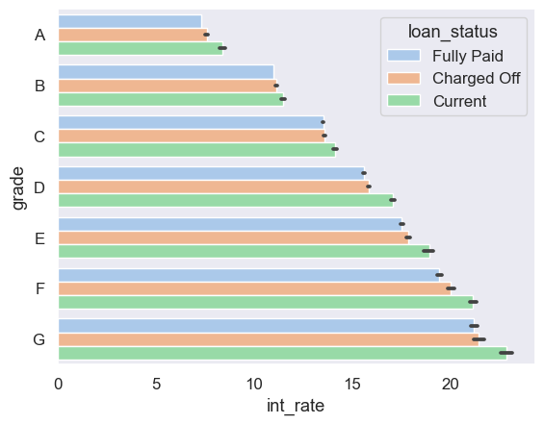
Grade vs Loan Status
Duration vs Loan Status

Slide 16
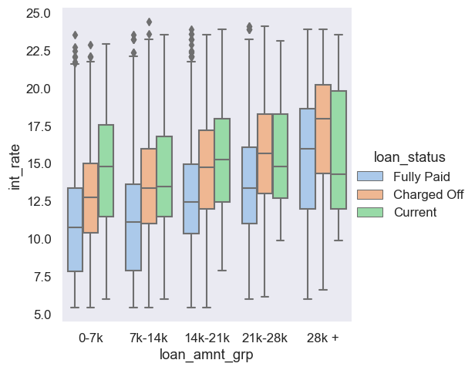
Interest rate vs annual income vs status

Slide 17
Observations
The number of loans defaulted are the highest in the loan pupose"debt_consolation",
But the annual income is not the highest.
The Loan is higher for all the income groups ,people who defaulted.
The interest rate for charged off loans is higher , compared to that of fully paid loans
in all the groups. This is a driving factor for loan defaulting.
The loan was sanctioned/issued in December are maximum defaulted and Loans
issued in the year 2011 are also higher comparing other years
Employees with highest tenure in an organization got higher Loan amount.

Slide 18
Recommendations
Modest interest for all types of loan would help in minimizing load default rate
Higher income group and lower income group , moderate loan amount would help in reducing defaulters
The number of loans defaulted are the highest in the loan pupose"debt_consolation", number of loans, loan amount can be reduced
December month loans seems seasonal with high default rate, thus can pushed to a
month before or later , gives time to employees think and apply for loans
Employees with highest tenure likely to repay the loan successfully

Slide 19
THANK YOU
Elayaraja Muthuraj
Elaya.m@gmail.com
Elaya1984 (github.com)

